Slide 1

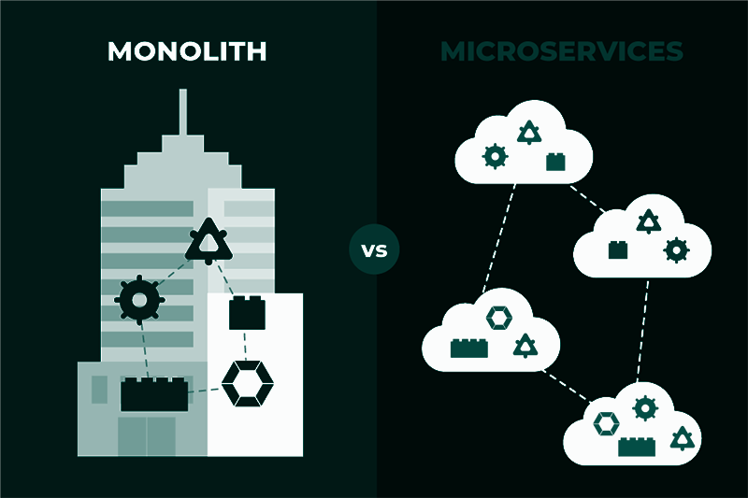
TEAM OVERCLOUDED
Abhishek Papanur | Rishav Naskar | Bubai Mondal

Slide 2
Topics Covered:
Monolithic Architecture
Microservice Architecture
Pros and Cons of Monolithic Architecture
Pros and Cons of Microservice Architecture

Slide 3
Monolithic Architecture

Slide 4
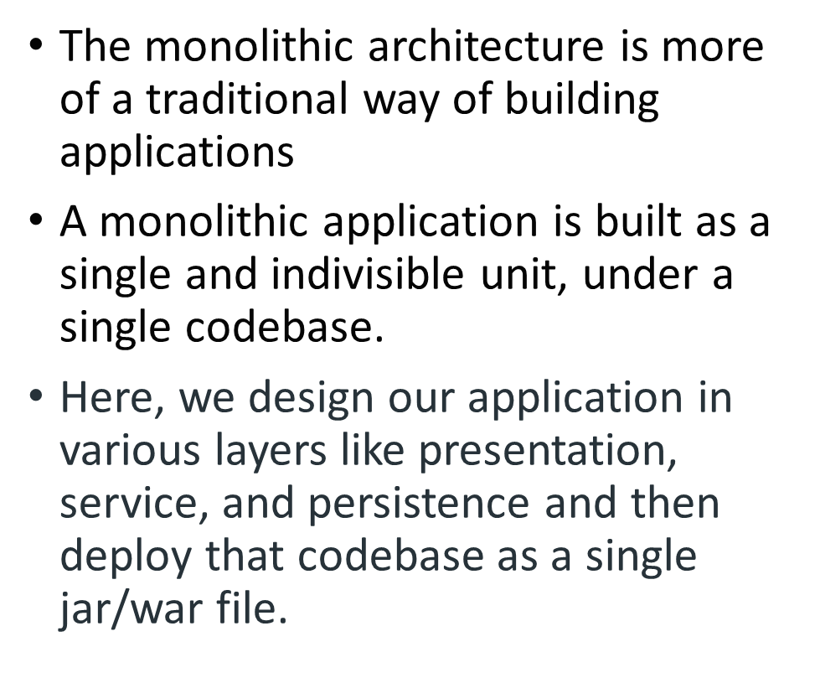
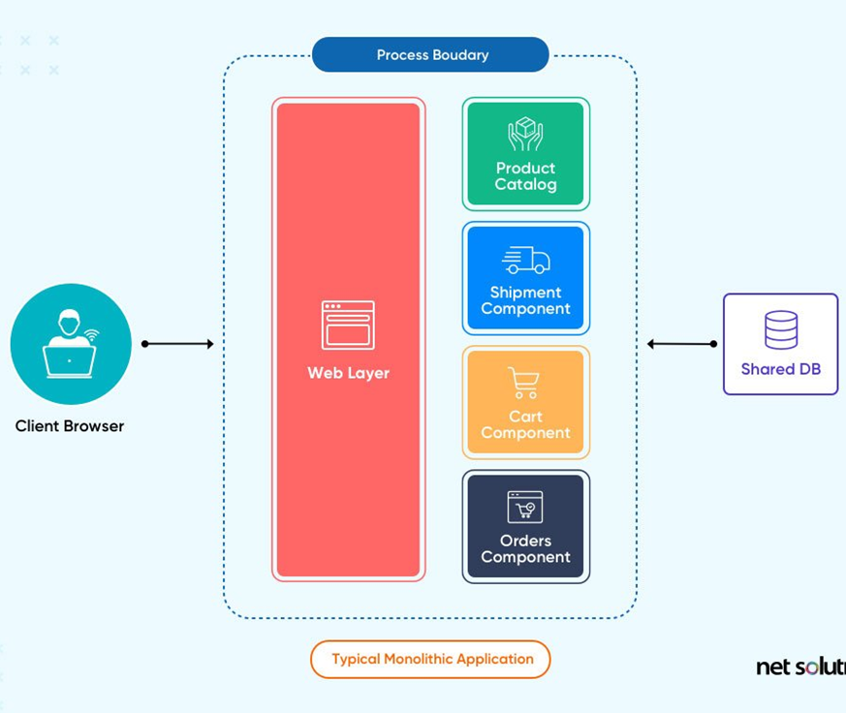
Monolithic Architecture

Slide 5
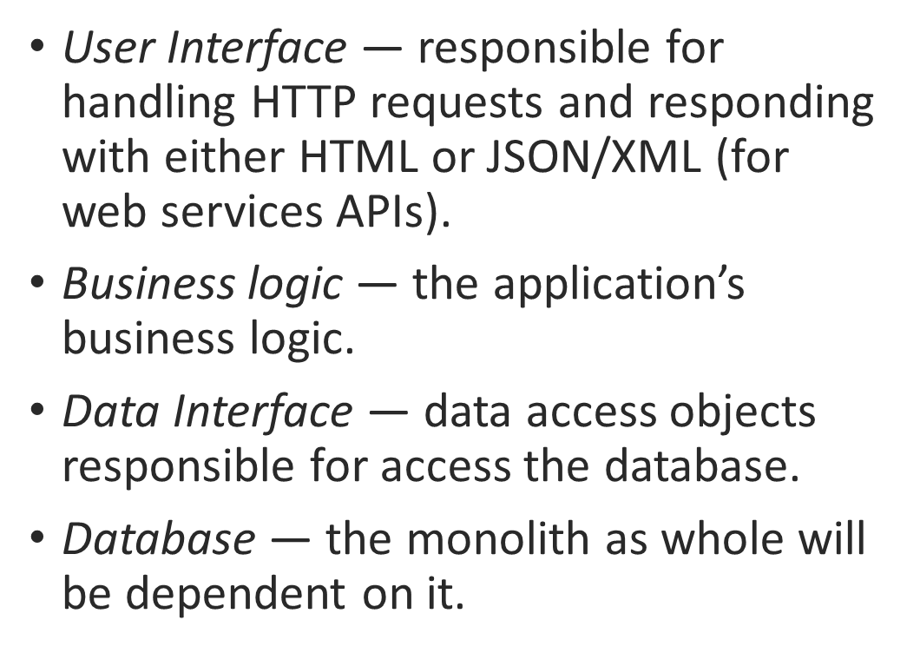
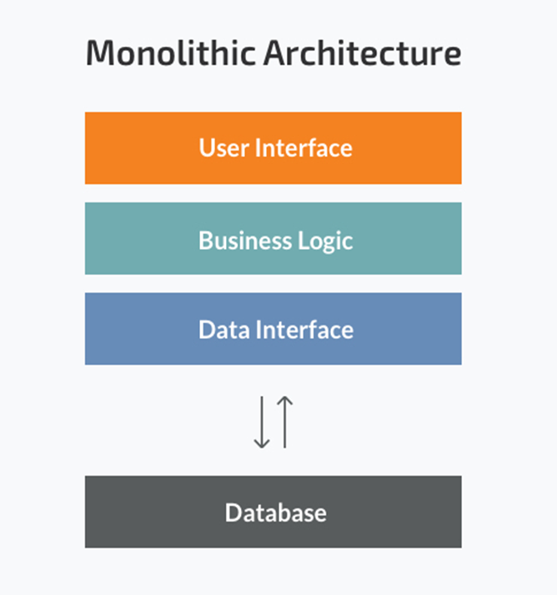
For example…

Slide 6
Microservices

Slide 7
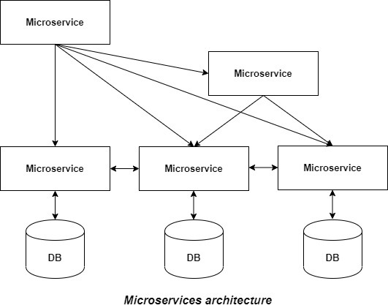
Definition: It is an architectural development style in which the application is made up of smaller services/codebases (each responsible for one specific task) communicating with each other directly using certain lightweight protocols.
How are microservices loosely coupled and designed for failure?
MICROSERVICES ARCHITECTURE

Slide 8
Pros and Cons of Monolithic Architecture
Pros
These are easier to develop.
These are easier to test by simply launching the application and do end-to-end testing.
These are easier to deploy.
Reduced network latency.
Cons
Huge application size and complexity makes it difficult to make changes to it.
These are difficult as each service might have different requirements.
As all services are tightly coupled in these, bug in any service can bring down the whole application.

Slide 9
Pros and Cons of Microservice Architecture
Pros
It tackles the problem of complexity by decomposing application into a set of manageable services which are much faster to develop.
It enables each service to be developed independently by a team that is focused on that service
Microservice architecture enables each microservice to be deployed independently.
Cons
Microservices has the partitioned database architecture.
Increased complexity in communication.
Testing a microservices application is also much more complex than in case of monolithic web application.

Slide 10
THANK YOU

